Slide 1


ASSESSMENT AT THE END OF KEY STAGE 2
Hove Junior School

Slide 2

AIMS AND OBJECTIVES
To provide information about
the assessment process at the
end of Year 6.
Share key information about
the National Curriculum tests.

Slide 3

PREVIOUS RESULTS
Hove Juniors - Percentage of children achieving the expected standard/working at greater depth:
Reading:
Attainment for reading is 87% with 46% working at greater depth.
ARE - Brighton & Hove – 75% (+12%) National – 73% (+15%)
GDS - Brighton & Hove – 34% (+12%) National – 29% (+17%)
Writing:
Attainment for writing is 83% with 16% working at greater depth.
ARE - Brighton & Hove – 71% (+12%) National – 71% (+12%)
GDS - Brighton & Hove – 11% (+5%) National – 13% (+3%)

Slide 4
Maths:
Attainment for maths is 82% with 33% working at greater depth.
ARE - Brighton & Hove – 72% (+10%) National – 73% (+9%)
GDS - Brighton & Hove – 22% (+11%) National – 24% (+9%)
Spelling, Punctuation and Grammar (SPaG)
Attainment for SPAG is 85% with 43% working at greater depth.
ARE - Brighton & Hove – 71% (+14%) National – 72% (+13%)
GDS - Brighton & Hove – 29% (+14%) National – 30% (+13%)
Reading, Writing & Maths Combined:
Attainment for R/W/M is 75% with 12% working at greater depth.
ARE - Brighton & Hove – 59% (+16%) National – 59% (+16%)
GDS - Brighton & Hove – 6% (+6%) National – 8% (+4%)

Slide 5
NATIONAL CURRICULUM TESTS
In year 6, all pupils in England take the National Curriculum tests (SATs) in mathematics, reading, grammar, punctuation and spelling.
These take place as follows:
Monday 13th May | Grammar, Punctuation and Spelling
Tuesday 14th May | Reading
Wednesday 15th May | Arithmetic Paper 1 Mathematical Reasoning Paper 2
Thursday 16th May | Mathematical Reasoning 3

Slide 6
NATIONAL CURRICULUM TESTS
These will be the first formal national exams the children will take. They are marked externally and will be used to inform league tables this academic year which is a return to pre-pandemic expectations.
The results are shared with secondary school. They will indicate if your child is secondary ready. Therefore, Year 7 teachers will be able to view their incoming pupils’ scaled scores so that they can prepare for their new intake. This will include groupings, sets and classes.
Notes:
Self esteem – children measure themselves compared to peers and expectations. We do not want any child to leave this school feeling as if they have failed.

Slide 7

TEST WEEK ORGANISATION
Children have to sit the tests under certain conditions – no talking, no moving around the room, hands up to ask a question and test front covers to be completed as explained.
We aim to keep the tests as close to ‘normal’ classroom conditions as possible and the children will be used to this from previous practice tests.
Some children will require extra support for example:
  Extra time
  A prompter or reader on certain papers
  A scribe
  Modified papers

Slide 8
THE RESULTS
We will share your child’s results at the end of the year in their reports. In their reports, you will be given the following information:
A raw score – In each of the three areas assessed, your child will receive a raw score e.g. out of 110 for Maths
A scaled score confirmation of whether or not they attained the national standard. This ranges from 80 through to 120 and shows how your child’s result compares to the national average. A scales score of 100 in SATs will mean that they have met the national expectation.

Slide 9
THE PAPERS
The KS2 tests consist of:
    English reading: reading booklet and associated answer booklet. 3 sections. 50 marks. (1 hour)
    English grammar, punctuation and spelling Paper 1: short answer questions. 50 marks (45 minutes)
    English grammar, punctuation and spelling Paper 2: spelling. 20 marks. (untimed )
    Mathematics Paper 1: arithmetic – 40 marks (30 minutes)
    Mathematics Paper 2: reasoning – 35 marks (40 minutes)
    Mathematics Paper 3: reasoning – 35 marks (40 minutes)
The tests will include a small number of questions designed to assess the most able pupils so separate tests, such as the previous level 6 tests, are no longer required.

Slide 10
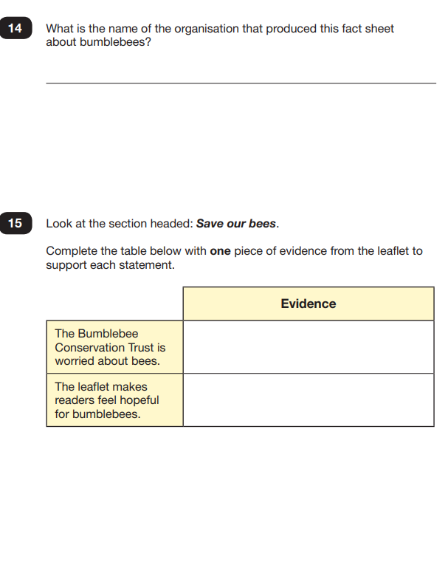
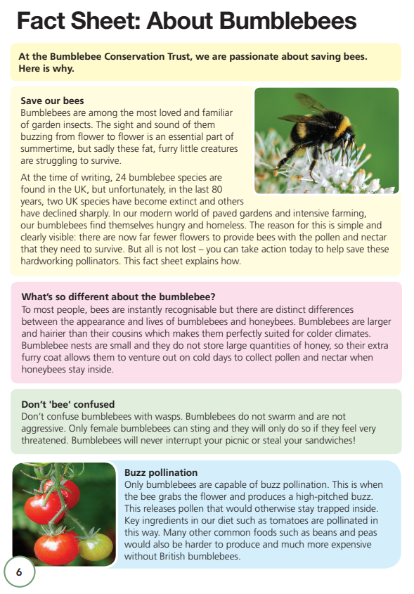
Notes:
Make sure that you do not read the paper to the pupil. The paper is divided into 3 different sections.
Encourage the child to read it section by section. The sections are not related. The Year 6 team will have taught them like this and the majority of the pupils receiving extra time will have processing difficulties so would not be able to retain all of the information.

Slide 11
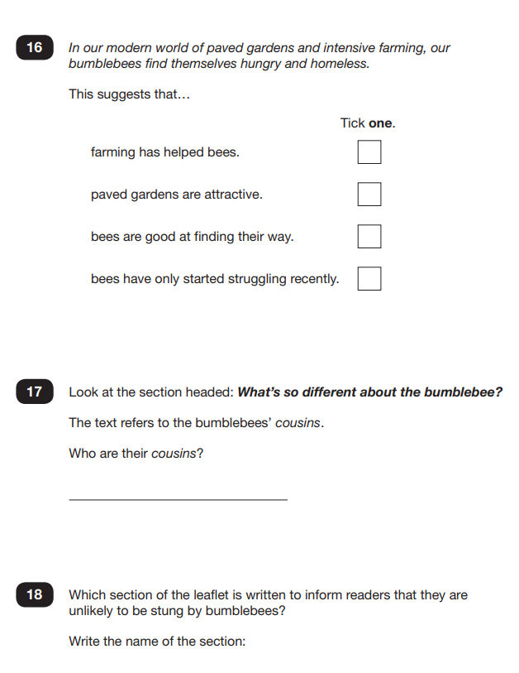
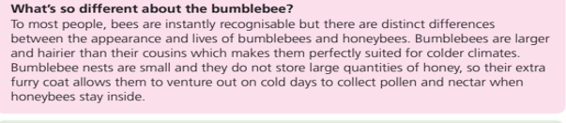
Notes:
You can not read the sections but you can get the children to read the question out loud which will generally help them to think and process what the question is asking them.
Many of the questions also have a subheading to refer to which can help direct the pupil to retrieving the information they need to answer the question.

Slide 12
READING SKILLS AND STAMINA
This tests pupils ability to:
  Give / explain the meaning of words in context.
  Retrieve and record information / identify key details from fiction and non-fiction.
  ‘Copy and find…’
  Summarise main ideas from more than one paragraph.
  Make inferences from the text / explain and justify inferences with evidence from the text.
  Predict what might happen from details stated and implied.
  Identify / explain how information / narrative content is related and contributes to meaning as a whole.
  Identify /explain how meaning is enhanced through choice of words and phrases.
  Make comparisons within the text.

Slide 13

GRAMMAR AND PUNCTUATION
This tests the following areas:
  Understanding of grammatical terms and word classes.
  Functions of sentences
  How words, phrases and clause can be combined
  Verb forms, tenses and consistency
  Punctuation
  Vocabulary
  Understanding of standard English and formality.
Children must know and understand a wide range of technical words.
They also must be precise with their answers.

Slide 14
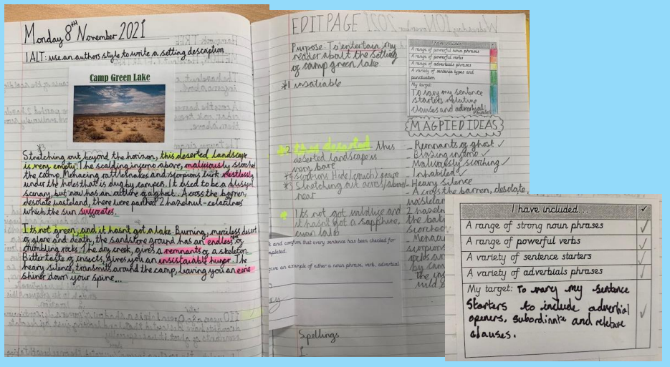
GRAMMAR AND PUNCTUATION

Slide 15
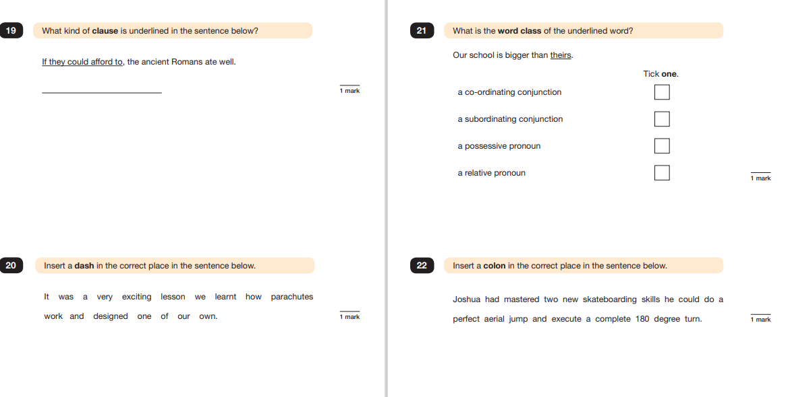

Slide 16
SPELLING
Words will include the following:
  Common exception words
  Words with suffixes
  Words with prefixes
  Long vowel sounds
  Words following a range of spelling patterns (e.g. words ending in –ant, –ance, –ancy, –ent, –ence, –ency)
  Words with common letter strings (e.g. ough)
  Words with silent letters
  Homophones
  They may include, but will not exclusively be, the example year 5 and 6 words in the NC.

Slide 17
accommodate accompany according achieve aggressive amateur ancient apparent appreciate attached available average awkward bargain bruise category cemetery committee communicate community competition conscience* conscious* controversy convenience correspond | criticise (critic + ise) curiosity definite desperate determined develop dictionary Disastrous embarrass environment equip (–ped, –ment) especially exaggerate excellent existence explanation familiar foreign forty frequently government guarantee harass hindrance identity immediate(ly) | individual interfere interrupt language leisure lightning marvellous mischievous muscle necessary neighbour nuisance occupy occur opportunity parliament persuade physical prejudice privilege profession programme pronunciation queue recognise recommend | relevant restaurant rhyme rhythm sacrifice secretary shoulder signature sincere(ly) soldier stomach sufficient suggest symbol system temperature thorough twelfth variety vegetable vehicle yacht

Slide 18
ARITHMETIC
This test lasts 30 minutes.
There are a total of 40 marks. Most questions are 1 mark questions, but some are 2 marks.
With a 2 mark question, you can gain a mark for a correct method, allowing for a single calculation error.
The focus is on each pupil’s confidence with a range of mathematical operations.
This test is quick paced and requires the children to have a strong grasp of number sense and formal methods for all 4 operations.

Slide 19
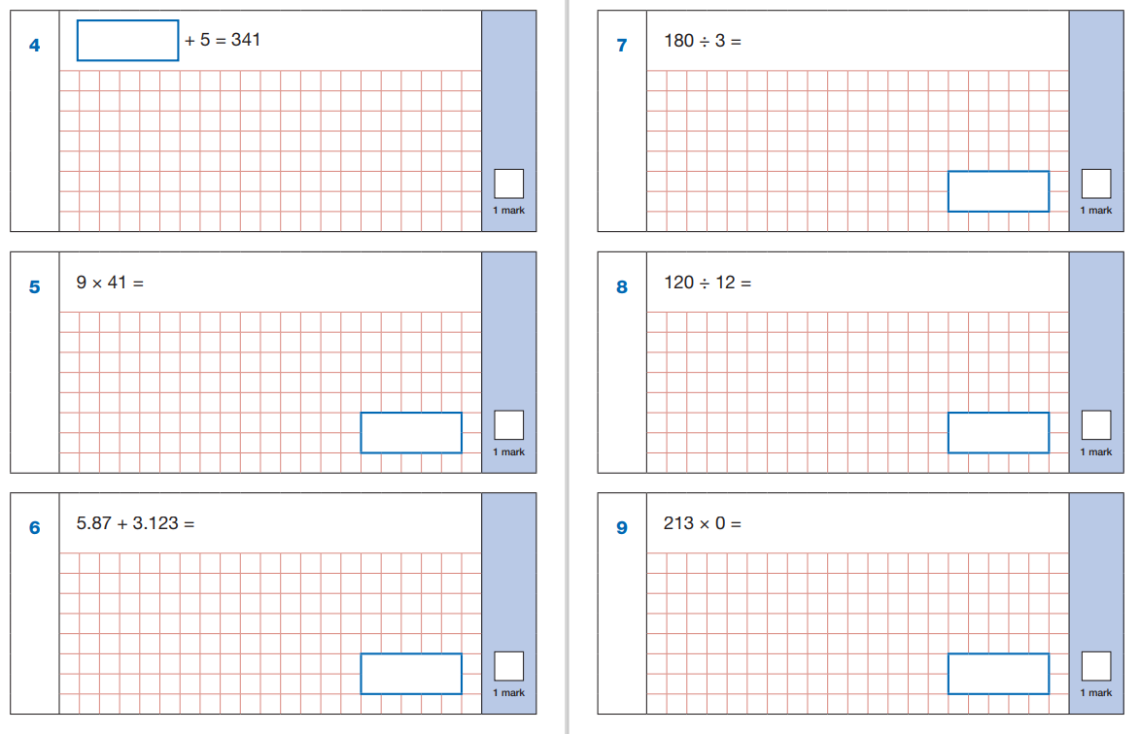

Slide 20
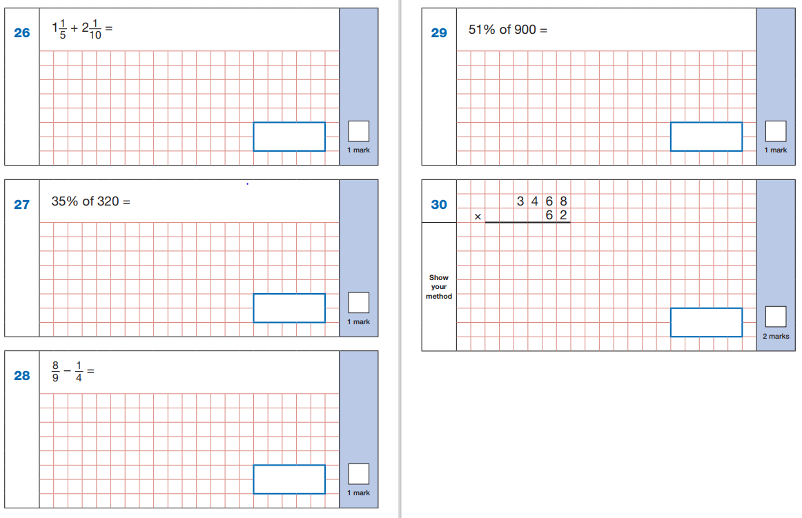

Slide 21
REASONING
There are two tests, each lasting 40 minutes.
They are each worth 35 marks.
They test pupil’s mathematical fluency, ability to solve mathematical problems and mathematical reasoning skills.
Some questions are worth 2 or even 3 marks. Children will get marks for correct methods, even if there is a calculation error.

Slide 22
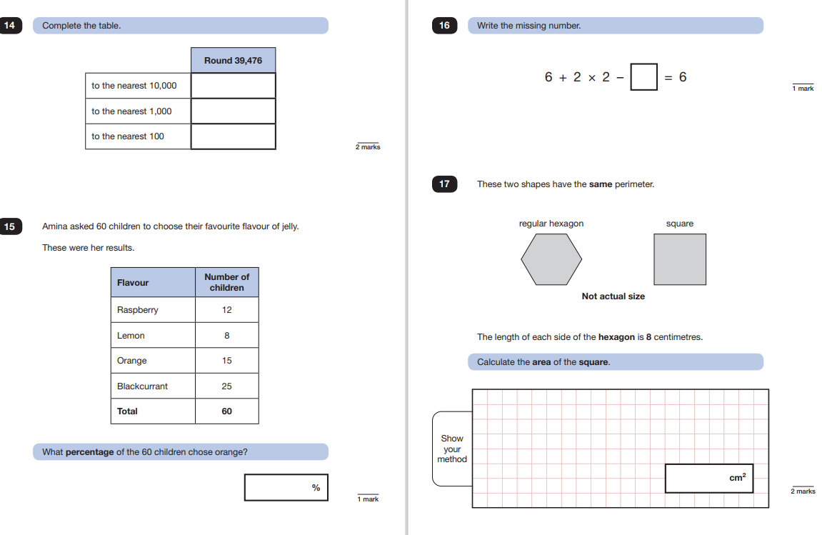

Slide 23
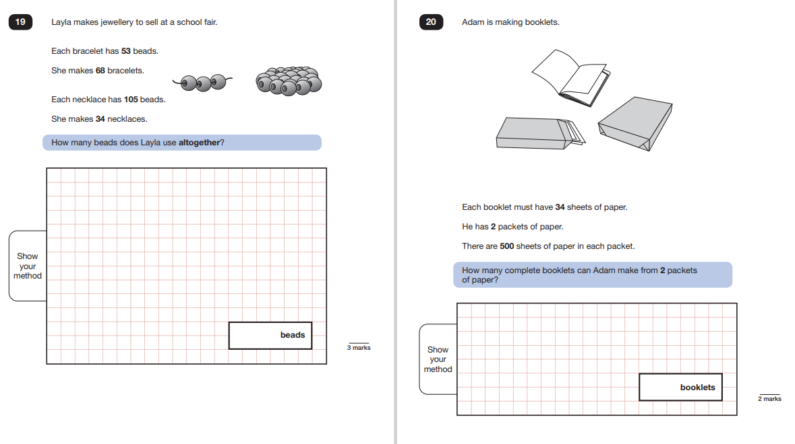

Slide 24
WHAT CAN I DO TO HELP?
• Reading a wider range of age appropriate texts
• Times tables
• Maths in real life contexts
• Home learning
• Spelling
• School website – sample papers and SPAG glossary

Slide 25
QUESTIONS…

